Slide 1
Lec 12

Slide 2
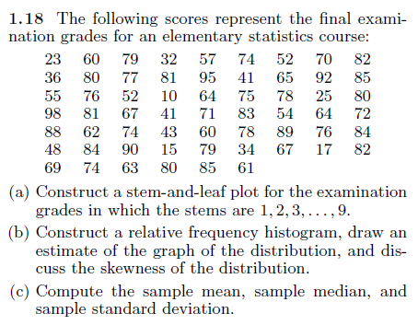
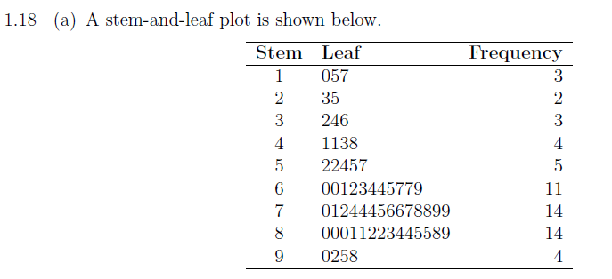
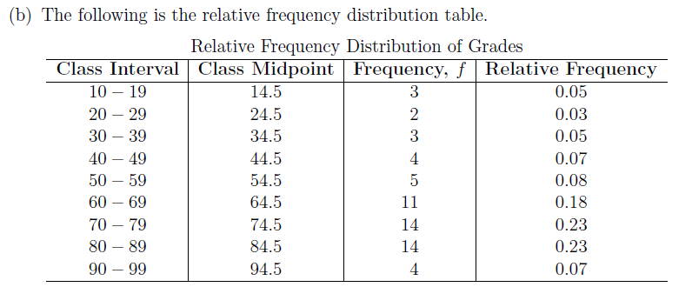
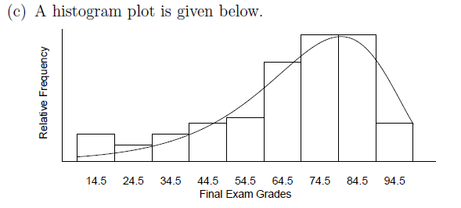

Slide 3
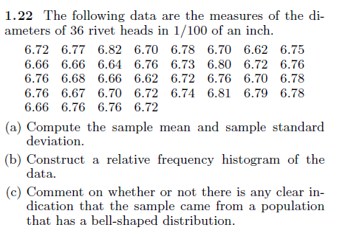
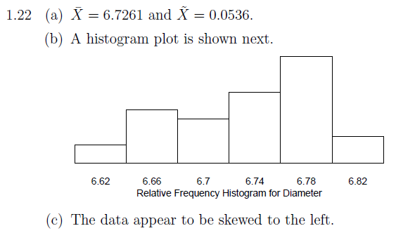

Slide 4
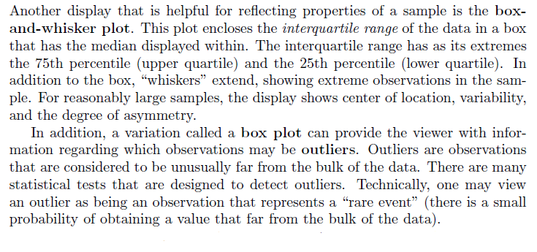
Box and Whisker plot

Slide 5
Steps
1. Numerical Order
2. Find the median
3. Find Lower Quartile (left median)
4. Find Upper Quartile (right median)
5. Draw number line
6. Plot Lower & Upper Quartile, Median, Minimum & Maximum

Slide 6
Example
Use the given data to make a box-and-whisker plot.
Draw a number line and plot a point above each value from Step 1.
13 15 17 19 19 21 21 25
12 14 16 18 20 22 24 26 28

Slide 7
Additional Example 2 Continued
Use the given data to make a box-and-whisker plot.
Step 3. Draw the box and whiskers.
13 15 17 19 19 21 21 25
12 14 16 18 20 22 24 26 28

